Slide 1
Welcome to English!
Sign-In at the Table and Provide Parent Contact Information
Visit Ms. Peel’s Website at peelsenglish.weebly.com

Slide 2
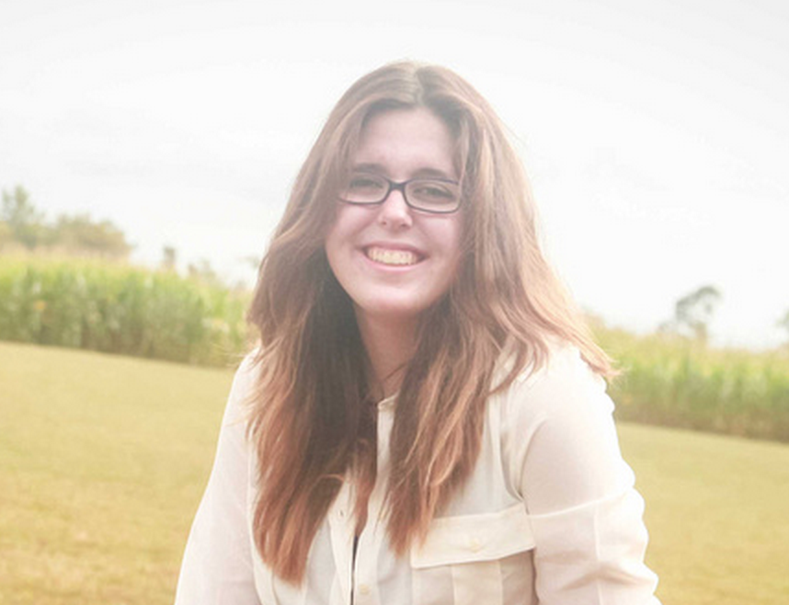
About ms. Peel
From Hillsborough, NC
Graduated from Elon University
Teaches Honors English I, Honors English II, Honors English IV, and Media and Journalism
Loves to read (Huge Nerd ☺)
Avid Horseback rider.
Sign-In at the Table and Provide Parent Contact Information
Check out Ms. Peel’s website at peelsenglish.weebly.com

Slide 3
Contact information
See Ms. Peel’s website at peelsenglish.weebly.com for syllabus, supply list, classroom policies and procedures etc.
Email at abigailpeel@cgsnc.org
Call at Clover Garden School at extension 403
Sign-In at the Table and Provide Parent Contact Information
Check out Ms. Peel’s website at peelsenglish.weebly.com

Slide 4
Ask ms. Peel about
Honors and Classroom Expectations
Independent Reading Time
Books in the Classroom Library
Process Grades v. Check-Plus Grades
Annotation Notebooks v. Daily Journals
Sign-In at the Table and Provide Parent Contact Information
Check out Ms. Peel’s website at peelsenglish.weebly.com

Slide 5
Student Supply List
Writing Utensils (pencils, blue or black ink pens)
White Out
Loose Leaf Paper (College Ruled)
Folder or Binder (to store handouts and notes)
Markers or Colored Pencils
Highlighters (Multiple colors)
Index cards (5x3)
Sticky notes
CHARGED LAPTOP
A book that you enjoy reading (either checked out from a library or owned)
Sign-In at the Table and Provide Parent Contact Information
Check out Ms. Peel’s website at peelsenglish.weebly.com

Slide 6
Classroom Supply Needs
Tissues
Paper Towels
Colored Printer Paper
Cleaning supplies (Board Cleaner, Windex, Clorox Wipes, etc.)
Scissors, tape
Staplers and staples
Paperclips and paper binders
Pens, white-out, pencils, markers, highlighters, loose leaf paper (College-Ruled)
Books appropriate for 9-12 classroom
Sign-In at the Table and Provide Parent Contact Information
Check out Ms. Peel’s website at peelsenglish.weebly.com

